Slide 1
Memory and storage
Bits & Bytes

Slide 2
agenda
Memory Allocation
Size of data
Data encoding
Number bases
Overview
Decimal
Binary
Hexadecimal
Bases conversions
Decimal ➔ Hexadecimal ➔ Decimal
Hexadecimal ➔ Binary ➔ Hexadecimal
Binary ➔ Decimal ➔ Binary
Memory encoding/storage
Complements
Endian
Garbage Collection

Slide 3
Memory allocation
Size of data
All information (programs and data) is a computer is stored in binary form
Binary means base 2, or as it is often called “ones and zeroes”
To properly manage resources, the developer often needs to keep track of how much memory is being used by a program
Memory terms
Bit – a single 1 or 0
Nibble – a collection of 4 bits
Byte – a group of 8 bits
Word & DWord – 2 bytes / 4 bytes (size may vary depending on specific computer platform)

Slide 4
Memory allocation
Data encoding
Types of encoding
Value types are stored using encoding specifically for each data type
Integrals use simple mathematic binary encoding
Negative integrals use twos-complement to represent negative values
Floating-point values are stored with values representing three different parts
Sign bit – 0/1 ➔ positive/negative
An exponent
A mantissa
The mantissa is raised to the exponent, then the sign is applied

Slide 5
Memory allocation
Data encoding
Types of encoding
Characters are stored using 1, 2 or 4 bytes (UTF-8, UTF-16 or UTF-32)
UTF/Unicode is a character encoding system based on ASCII (pronounced as-key) where each character is assigned a numeric equivalent (for example, the character ‘A’ has a value of 65 (decimal) or 41 (hexadecimal)
The original ASCII encoding scheme was developed in the US. As other countries adopted the system, it was necessary to expand it beyond its original 7 bits (values 0-127) so that letters from other alphabets (such as Cyrillic) could be encoded. The early implementations were called ‘extended ASCII’
Extended ASCII was still not adequate for some character sets (such as Kanji, katakana or hiragana) which led to the development of Unicode. There are several different Unicode schemes but almost all still use the original 0-127 values for the Latin (English) alphabet

Slide 6
Memory allocation
The same group bits/bytes can represent a variety of data using the same bit pattern
Example, the binary value: 0100 0000 1111 0000 0000 0000 0000 0000 can represent
The int value 1,089, 470, 464 (or 40 F0 00 00 in hexadecimal)
The floating-point value 7.5
The ASCII characters @ ð null null
The UTF-16BE character 䃰 (the CJK character for rock or stone)
It is the responsibility of the programming language/compiler to correctly encode/decode the binary values from/to actual meaining

Slide 7
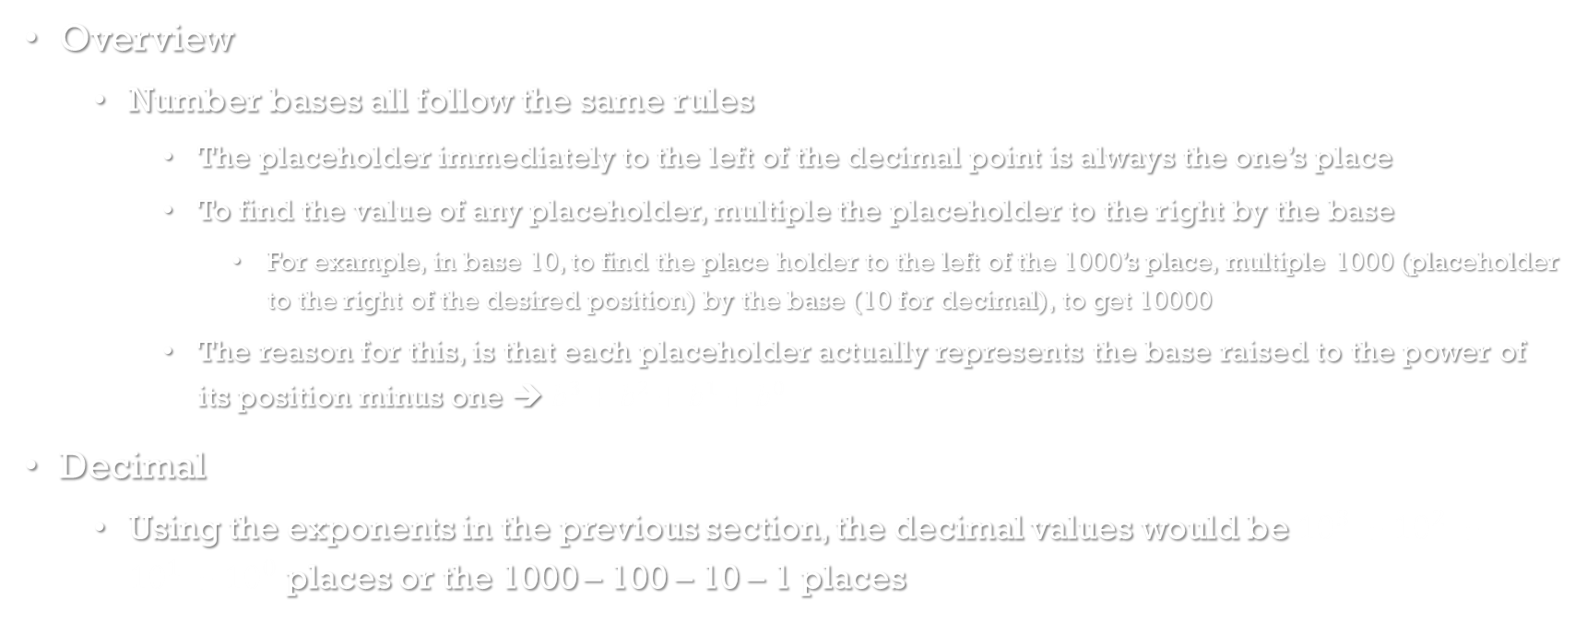
Number bases
Overview
Number bases all follow the same rules
The placeholder immediately to the left of the decimal point is always the one’s place
To find the value of any placeholder, multiple the placeholder to the right by the base
For example, in base 10, to find the place holder to the left of the 1000’s place, multiple 1000 (placeholder to the right of the desired position) by the base (10 for decimal), to get 10000
The reason for this, is that each placeholder actually represents the base raised to the power of its position minus one ➔ $b^{3}+b^{2}+b^{1}+b^{0}$
Decimal
Using the exponents in the previous section, the decimal values would be ${10}^{3}+{10}^{2}+{10}^{1}+{10}^{0}$ places or the 1000 – 100 – 10 – 1 places

Slide 8
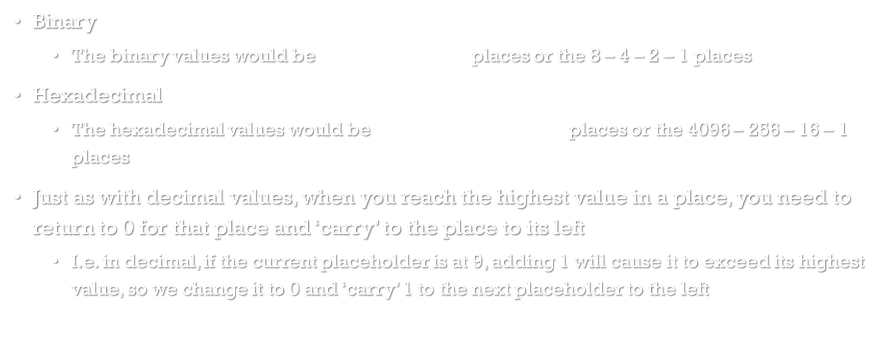
Number bases
Binary
The binary values would be $2^{3}+2^{2}+2^{1}+2^{0}$ places or the 8 – 4 – 2 – 1 places
Hexadecimal
The hexadecimal values would be ${16}^{3}+{16}^{2}+{16}^{1}+{16}^{0}$ places or the 4096 – 256 – 16 – 1 places
Just as with decimal values, when you reach the highest value in a place, you need to return to 0 for that place and ‘carry’ to the place to its left
I.e. in decimal, if the current placeholder is at 9, adding 1 will cause it to exceed its highest value, so we change it to 0 and ‘carry’ 1 to the next placeholder to the left

Slide 9
Number bases
Decimal values
Binary values
Hexadecimal values
0
1
2
3
4
5
6
7
8
9
10
11
12
13
14
15
0000
0001
0010
0011
0100
0101
0110
0111
1000
1001
1010
1011
1100
1101
1110
1111
0
1
2
3
4
5
6
7
8
9
A
B
C
D
E
F

Slide 10
Base Conversions
The process of converting from decimal to any other base is the same for all bases
Find the largest placeholder that is less than the decimal value being converted
Perform integer division on the decimal value, dividing it by the placeholder
Record the resulting value in the placeholder
Perform modulo division on the decimal value, dividing it by the placeholder
Use the remainder from step 3, and repeat steps 2-4 until the one’s place is reached
Record the remainder from step 4 in the one’s place

Slide 11
Base Conversions
Example – convert the decimal value 962 to hexadecimal
Find the largest placeholder that is less than the decimal value being converted 962 would be between the 4096 and 256 placeholders, so start with the 256 placeholder
Perform integer division on the decimal value, dividing it by the placeholder 962 / 256 = 3 194 / 16 = 12 or C
Record the resulting value in the placeholder 3 C 2
Perform modulo division on the decimal value, dividing it by the placeholder 962 % 256 = 194 194 % 16 = 2
Use the remainder from step 3, and repeat steps 2-4 until the one’s place is reached
Record the remainder from step 4 in the one’s place 962 (decimal) equals 3C2 hexadecimal (written as 0X3C2 – the 0X means hexadecimal)

Slide 12
Base Conversions
The process of converting to decimal from any other base is the same for all bases
Start with either the largest placeholder or the one’s placeholder
Multiple each placeholder by the value in the placeholder
Find the sum of all the products from set 2
Example – Convert 0x25B6 to decimal
Start with the 4096 place, multiply that by 2 = 8192
Move to the 256 place, multiply that by 5 = 1280
Move to the 16 place, multiply that by B (11) = 176
Finally the 1’s place is 6 (6 X 1 is 6) = 6 = 9654

Slide 13
Base Conversions
We’ll do some practice problems on the board now
Decimal to hexadecimal
Hexadecimal to decimal
Hexadecimal to binary
Binary to hexadecimal
Decimal to binary
Binary to Decimal

Slide 14
Encoding and storage
Adding/subtracing binary values
This is the same as decimal addition/subtract
The difficult part is keeping track of carries/borrows
Examples (on board)

Slide 15
Encoding and storage
Complements
Purpose – complements provide a way to represent negative values in binary
Ones complement – The negative value is represented by the binary inverse of the positive value, not used. It has two different representations of 0 (positive 0 and negative 0)
Twos complement – The negative values is represented by a slight modification to the ones complement
Find the one’s complement, then add one to the complement
Examples (on board)

Slide 16
Encoding and storage
Endianness – refers to how bytes are arranged in memory
Big endian – the high order (most significant) bytes are stored first/to the left
Little endian – the high order bytes (most significant) bytes are stored last/to the right
The byte order is exactly opposite
Don’t confuse byte order with bit order
Examples (on board)

Slide 17
Garbage collection
To keep the maximum amount of memory available to a program, it is necessary to free up memory when it is no longer being used
This is the responsibility of the Garbage Collection
In C# this happens automatically
Runs when the program has ‘extra’ processing cycles available
Can be called by a program to run immediately
The process of Garbage Collection is simple, any program data that is no longer being used and has gone out of scope is eligible to be garbage collected
Setting a reference to null, makes that reference eligible for garbage collection

